Slide 1
The advantages of city life and country life

Slide 2

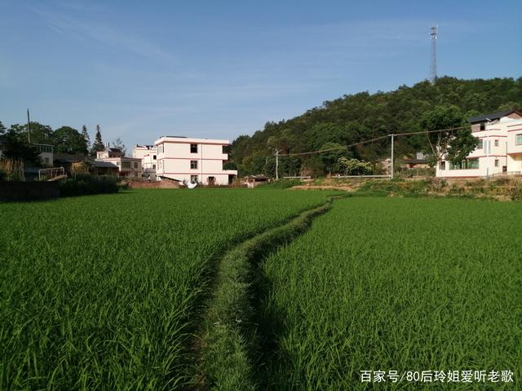


议程
The convenient and efficient life
The relax and healthy life
简介
主要目标
增长领域
日程表
摘要

Slide 3
In the city , there are
In the country , there are
Good service
More shops and supermarkets
Lots of job opportunities
Higher salary
More convenient traffic
Beautiful scenery
Clear water and fresh air
Safer and quieter life
Slow lifestyle

